Slide 1
Variable
Selection
Looping

Slide 2
Basic Variable (Pembolehubah)
Whiteboard – Tulis/Simpan Data
1 data sahaja (nombor, perpuluhan, ayat)
3
unisza
$nombor = 3
echo $nombor
$ayat = "unisza"
echo $ayat

Slide 3
Array Variable (Pembolehubah)
Whiteboard – Tulis/Simpan Data
> 1 data sahaja (nombor, perpuluhan, ayat)
[0]
[1]
[2]
3
unisza
19.57
$x = array();
$x[0] = 3;
$x[1] = "unisza";
$x[2] = 19.57;
$x = array(3,"unisza",19.57);

Slide 4
Array Variable (Pembolehubah)
Whiteboard – Tulis/Simpan Data
> 1 data sahaja (nombor, perpuluhan, ayat)
[0]
[1]
[2]
3
3
unisza
19.57
$bil_row = count($x);
$x = array();

Slide 5
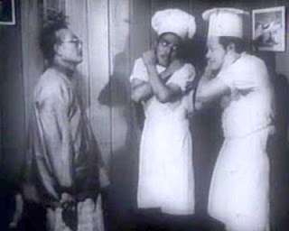
Looping
“Cuba ketuk ketampi sebanyak 10 kali tanpa mengira”
1
$i = 1;
$i=$i+1;
$i <= 10;
for ($i=1; $i<=10 ; $i= $i+1){
//ketuk ketampi
echo $i;
}

Slide 6
Looping
“Cetak semua kandungan whiteboard $x”
[0]
[1]
[2]
3
$x = array();
$x[0] = 3;
$x[1] = "unisza";
$x[2] = 19.57;
unisza
19.57
for ($i=0; $i<= count($x) ; $i= $i+1) {
echo $x[$i]."<br>";
}

Slide 7
Selection
if ($number == 10)
{
echo "Hai 10";
}
else if ($number > 10) {
echo "Hai 10 ke atas";
}
else
{
echo "Hai bukan 10";
}

Slide 8
MySQL
Connect DB
mysqli_connect("localhost", "root","","school");
$conn (whiteboard)

Slide 9
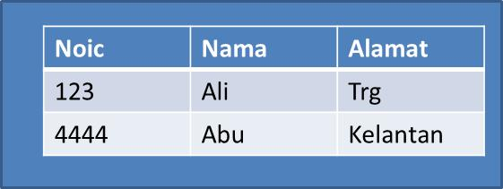
MySQL
Read Table // SQL Statement
$result = mysqli_query($conn, $sql);
$sql ="SELECT * FROM student";
$result (whiteboard)

Slide 10
MySQL
$row
Read Rows (cara pertama)
$total = mysqli_num_rows($result) ;
for ($i=0; $i < $total; $i++){
$row = mysqli_fetch_array($result);
echo $row['Noic']; //$row[0];
echo $row['Nama']; //[1]; echo $row[‘Alamat']; //$row[2];
}

Slide 11
MySQL
$row
Read Rows (cara kedua)
$total = mysqli_num_rows($result) ;
while ($row = mysqli_fetch_array($result)){
echo $row['Noic']; //$row[0];
echo $row['Nama']; //[1]; echo $row[‘Alamat']; //$row[2];
}

Slide 12
MySQL
Close DB
mysqli_close($conn);

